Slide 1

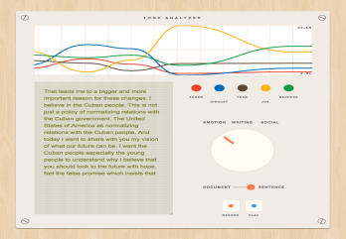
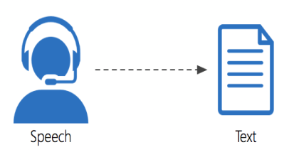
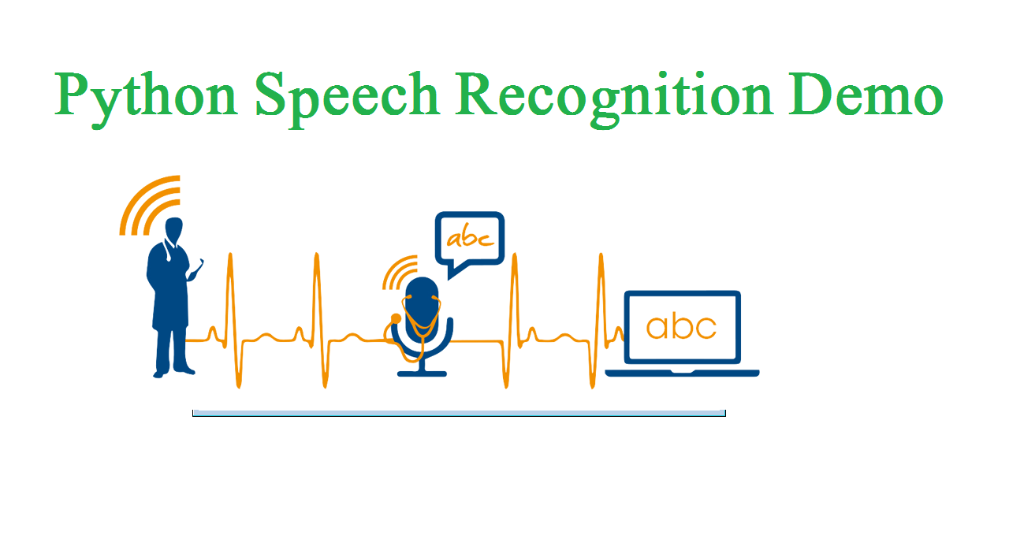
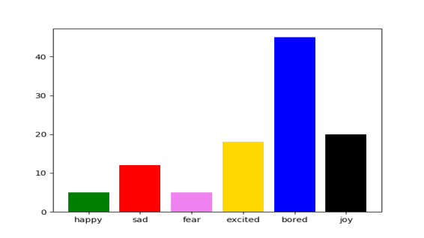
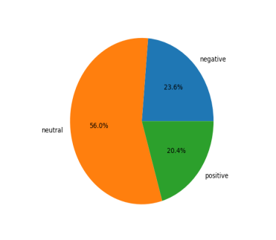
SENTIMENTAL ANALYSIS USING AUDIO(NLP)
INTRODUCTION
Sentimental analysis understands human emotions.
This uses the natural language processing to process voice data.
The emotions can be determined by getting the input voice from the customers and the and determine the emotions
To Improve the standard in a particular Area
To develop product quality and sales.
OBJECTIVE
To understand human feelings and to determine their emotions whether it is positive ,negative or neutral using natural language processing(NLP).
To determine human emotions in the audio.
To analyse their feedback for improving the product standard.
To Improve the standard in a particular Area
To develop product quality and sales.
NAME:M.PAVITHRA
S.R.PRIYAVARDHINI
S.SHRIPRIYA
MENTOR:MS.AIDA JONES
BATCH NO:B6
METHODOLOGY
Speech recognition system transcribes the audio to text
Input will be telephone conversation audio.
For identifying feedback of product.
Pre processing methods are Tokenization
stemming ,stop words removal , Lemmization and numbers removal.
After that text Pre-processing done followed by Naive Bayes algorithm is used for the classification purpose..
The emotions can be determined as postive ,negative and neutral.
RESULTS
The output of text analysis is positive negative and neutral and the output of tone analysis is happy sad angry fear etc
These two output combined to form the emotional output
FUTURE SCOPE
The future scope will be analyzing it with big data set.
Gender of the speaker can be identified.
Many languages can be used

